Slide 1
Financial Accounting
IFRS 5th Edition
Weygandt ● Kimmel
Chapter 9
Plant Assets, Natural Resources, and Intangible Assets
This slide deck contains animations. Please disable animations if they cause issues with your device.
Copyright © John Wiley & Sons, Inc.

Slide 2
Chapter Outline
Learning Objectives
LO 1 Explain the accounting for plant asset expenditures.
LO 2 Apply depreciation methods to plant assets.
LO 3 Explain how to account for the disposal of plant assets.
LO 4 Describe how to account for natural resources and intangible assets.
LO 5Discuss how plant assets, natural resources, and intangible assets are reported and analyzed.

Slide 3
Learning Objective 1 Explain the Accounting for Plant Asset Expenditures.
L O 1

Slide 4
Plant Assets
Plant assets are resources that
have a physical substance (a definite size and shape)
are used in the operations of a business
are not intended for sale to customers
are expected to be of use to the company for a number of years (unlike land, plant assets decline in service potential over their useful lives)
Referred to as property, plant, and equipment (PP&E); plant and equipment; and fixed assets.
L O 1
Notes:
Example: buildings. Equipment.
Supply → not plant asset.
Plant assets depreciate over time. Land does not (because it has unlimited useful life).

Slide 5





Plant Assets as % of Total Assets
Plant assets play a key role in ongoing operations.
Illustration 9.1: Percentages of plant assets in relation to total assets
L O 1

Slide 6
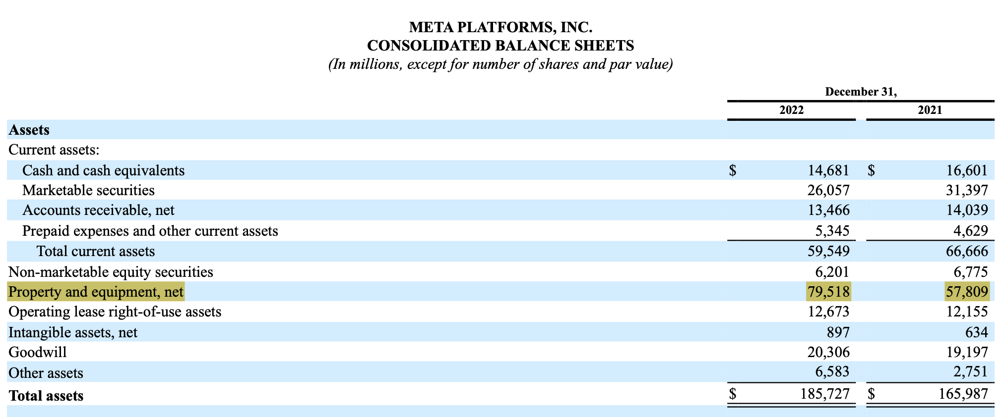
Where is PPE recorded?

Slide 7
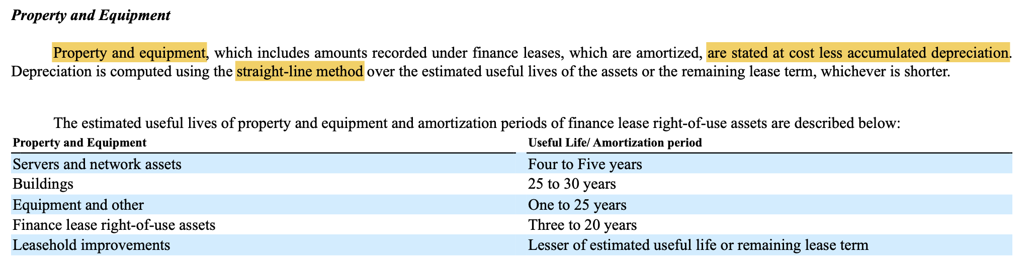
Meta’s PPE

Slide 8
Historical Cost Principle
Requires that companies record plant assets at cost
Cost consists of all expenditures necessary to acquire an asset and make it ready for its intended use
Inventory was record similarly
Delivery cost was also part of inventory … necessary cost to make it ready of its intended use
L O 1

Slide 9
The Cost of Plant Assets – Land
All necessary costs incurred in making land ready for its intended use increase the Land account (debit).
Costs typically include:
cash purchase price
closing costs such as title and attorney’s fees
real estate brokers’ commissions
accrued property taxes and other liens on land assumed by the purchaser
L O 1

Slide 10
Land Example
Illustration: Lew Ltd. acquires real estate at a cash cost of HK$2,000,000. The property contains an old warehouse that is razed at a net cost of HK$60,000 (HK$75,000 in costs less HK$15,000 proceeds from salvaged materials). Additional expenditures are the attorney’s fee, HK$10,000, and the real estate broker’s commission, HK$80,000. Determine the amount to be reported as the cost of the land.
L O 1
Notes:
Include all costs to compute cost of land.

Slide 11
Land Example – Solution
Required: Determine amount to be reported as the cost of the land.
Land
Cash price of property | HK$2,000,000
Net removal cost of warehouse (HK$75,000 − HK$15,000) | 60,000
Attorney’s fee | 10,000
Real estate broker’s commission | 80,000
Cost of land | HK$2,150,000
Illustration 9.2: Computation of cost of land
Lew makes the following entry:
Land 2,150,000
Cash 2,150,000
L O 1

Slide 12
The Cost of Plant Assets – Land Improvements
Cost includes all expenditures necessary to make the improvements ready for their intended use.
Examples: driveways, parking lots, fences, landscaping, and underground sprinklers
Limited useful lives
Note that land has unlimited useful life. Land improvements do not.
Expense (depreciate) cost of land improvements over their useful lives
L O 1

Slide 13
The Cost of Plant Assets - Buildings
Includes all costs related directly to purchase Purchase costs:
Purchase price, closing costs (attorney’s fees, title insurance, etc.) and real estate broker’s commission
Remodeling and replacing or repairing the roof, floors, electrical wiring, and plumbing
L O 1
Notes:
Purchased buildings → Zhiren, Zhixin, Letian bldg. … there were factories! Renovations were conducted. All these are considered part of cost.

Slide 14
Building Construction Costs
Includes all costs related directly to construction.
Contract price
Payments for architects’ fees
Building permits
Excavation costs
L O 1

Slide 15
The Cost of Plant Assets - Equipment
Include all costs incurred in acquiring the equipment and preparing it for use.
Costs typically include:
Cash purchase price
Sales taxes
Freight charges (if paid by the purchaser … FOB shipping point)
Insurance during transit paid by purchaser
Assembling, installing, and testing costs
L O 1
Notes:
What about insurance for usage? NO. This part of cost is after we get equipment ready for use… this is insurance expense.

Slide 16
Cost of Factory Machinery Example - Cost
Illustration: Assume Zhang Ltd. purchases factory machinery at a cash price of HK$500,000. Related expenditures are for sales taxes HK$30,000, insurance during shipping HK$5,000, and installation and testing HK$10,000.
Factory Machinery
Cash price | HK$500,000
Sales taxes | 30,000
Insurance during shipping | 5,000
Installation and testing | 10,000
Cost of factory machinery | HK$545,000
Illustration 9.3: Computation of cost of factory machinery
L O 1

Slide 17
Cost of Plant Assets Example - Cost
Illustration: Lenard Huang Group purchases a delivery truck at a cash price of HK$420,000. Related expenditures consist of sales taxes HK$13,200, painting and lettering HK$5,000, motor vehicle license HK$800, and a three-year accident insurance policy HK$16,000. Note: In HK, the vehicle license fee is a recurring cost subject to renewal every year or quarter.
Compute the cost of the delivery truck.
Delivery Truck
Cash price | HK$420,000
Sales taxes | 13,200
Painting and lettering | 5,000
Cost of delivery truck | HK$438,200
Illustration 9.4: Computation of cost of delivery truck
L O 1
Notes:
Purhcase price – tax, paint & lettering
License fee → 800, we should exclude… this is a recurring fee!
PPI → asset, but not plant asset.

Slide 18
Cost of Plant Assets Example - Journal
Illustration: Lenard Huang Group purchases a delivery truck at a cash price of HK$420,000. Related expenditures consist of sales taxes HK$13,200, painting and lettering HK$5,000, motor vehicle license HK$800, and a three-year accident insurance policy HK$16,000. Prepare the journal entry to record these costs.
Equipment 438,200
License Expense 800
Prepaid Insurance 16,000
Cash 455,000
L O 1
Notes:
License expense! → Recurring fee.
PPI → asset, but not plant asset.
If insurance only covers this year, we say insurance expense. Since this is 3 year, we use adjusting entries at end.

Slide 19
Expenditures During Useful Life
Ordinary Repairs are expenditures to maintain the operating efficiency and productive life of the unit. This is a recurring cost.
Debit to Maintenance and Repairs Expense
Referred to as revenue expenditures
directly record as expense
Additions and Improvements are costs incurred to increase the operating efficiency, productive capacity, or useful life of a plant asset.
Charge to asset first, then depreciate.
Debit plant asset affected
Referred to as capital expenditures
Recorded as asset first (we capitalize) then depreciate
L O 1

Slide 20
DO IT! 1: Cost of Plant Assets
Assume that Jing Feng Heating and Cooling purchases a delivery truck for ¥150,000 cash, plus sales taxes of ¥9,000 and delivery costs of ¥5,000. The buyer also pays ¥2,000 for painting and lettering, ¥6,000 for an annual insurance policy, and ¥800 for a motor vehicle license. Explain how each of these costs would be accounted for.
L O 1

Slide 21
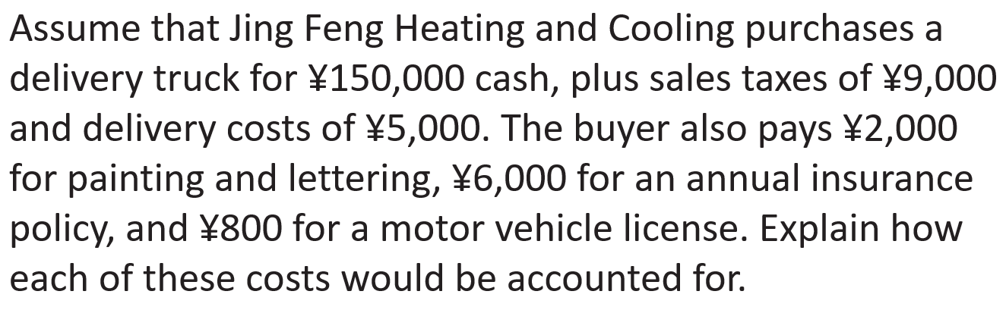






DO IT! 1: Cost of Plant Assets – Solution
The first four payments (¥150,000, ¥9,000, ¥5,000, and ¥2,000) are included in the cost of the truck (¥166,000)
150,000 cash
9,000 sales tax
5,000 delivery costs
2,000 painting and lettering
The payments for insurance and the license are operating costs and therefore are expensed
L O 1

Slide 22
Learning Objective 2 Apply Depreciation Methods to Plant Assets.
L O 2

Slide 23
Depreciation
Process of allocating to expense the cost of a plant asset over its useful life in a rational and systematic manner.
Applies to land improvements, buildings, and equipment (i.e., with a useful life span), not land
Depreciable, because the revenue-producing ability of these assets will decline over their useful lives
Does not apply to land: its usefulness and revenue-producing ability generally remain intact over time
L O 2

Slide 24
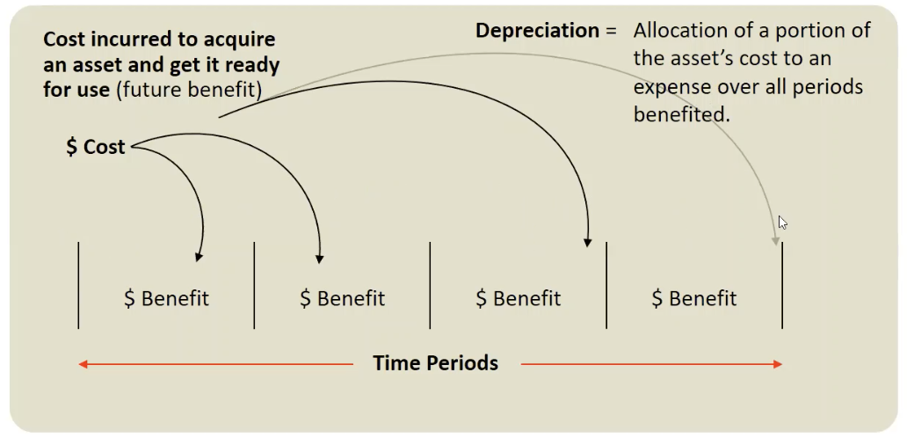
Depreciation Illustrated
Notes:
Divide the cost into number of useful life.

Slide 25
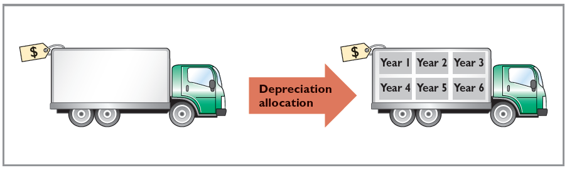
Depreciation as Allocation
Illustration 9.5: Depreciation as a cost allocation concept
L O 2

Slide 26
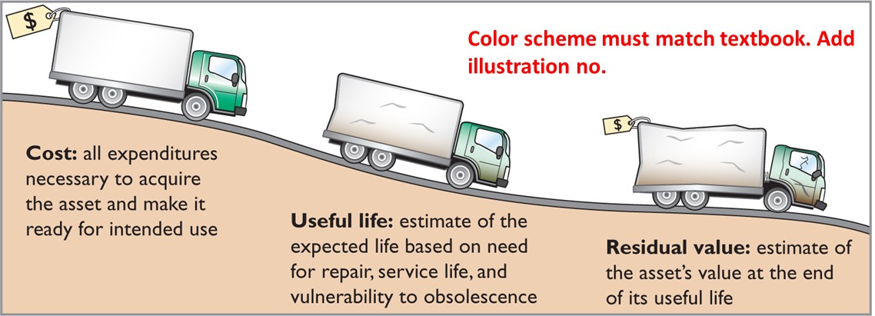
Factors in Computing Depreciation
Illustration 9.6: Three factors in computing depreciation
Depreciation expense is reported on the income statement. Accumulated depreciation is reported on the statement of financial position as a deduction from plant assets.
L O 2
Notes:
Cost: all expenditures necessary to acquire thea sset and make it ready for intended use
Useful life: estimate expected life … we estimate!
Residual value: estimate the asset’s value at the end of its useful life.

Slide 27
Depreciation Methods
Management selects the method it believes best measures an asset’s contribution to revenue over its useful life.
Examples include:
Straight-line method
Units-of-activity method
Declining-balance method
L O 2

Slide 28
Depreciation Methods – Example Data
Compare the three depreciation methods using the following data for a small delivery truck purchased by Barb’s Florists on January 1, 2025:
Cost | €13,000
Expected residual value | €1,000
Estimate useful life in years | 5
Estimated useful life in miles | 100,000
Illustration 9.7: Delivery truck data
Required: Compute depreciation using the following.
(a) Straight-Line (b) Units-of-Activity (c) Declining Balance
L O 2

Slide 29
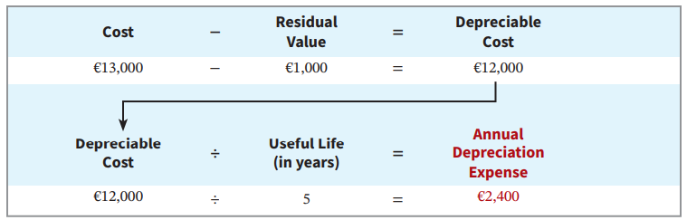
Straight-Line Method
Depreciable cost = Cost less residual value
Expense is the same amount for each year
Illustration 9.8: Formula for straight-line method
L O 2

Slide 30
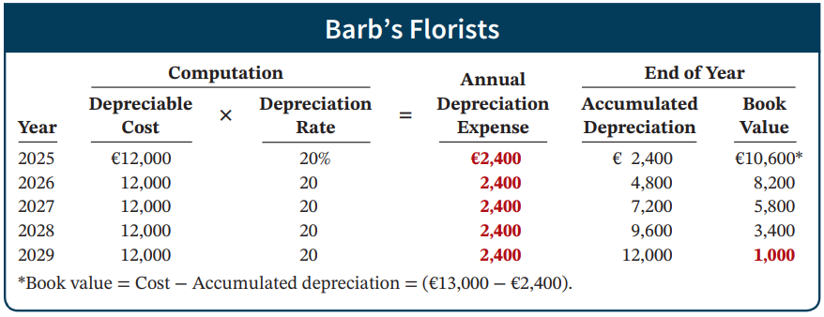
Straight-Line Method: Schedule
Illustration 9.9: Straight-line depreciation schedule
Journal entry at end of 2025:
Depreciation Expense 2,400
Accumulated Depreciation 2,400
L O 2
Notes:
Acc Dpr → how much depreciation has accumulated … this is contra asset.
BV --> Carrying value of asset … cost – acc dpr
Final BV → residual value.

Slide 31
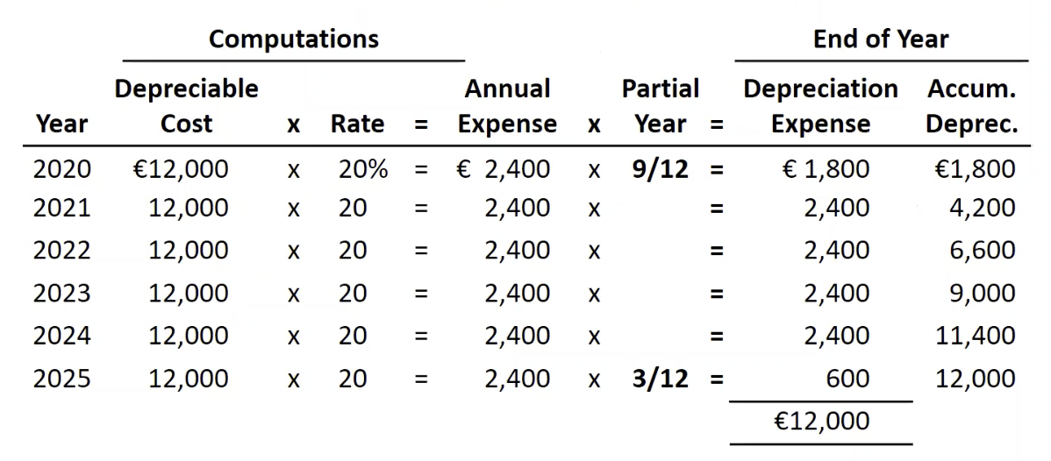
Straight-Line Continued
What if we bought the asset on 4/1/2025, instead of 1/1/2025?
Notes:
Partial years … 9 months in the beginning and 3 months at the end.

Slide 32
DO ITT! 2a: Straight-Line Depreciation
On January 1, 2025, Iron Mountain Ski Corporation purchased a new snow-grooming machine for €50,000. The machine is estimated to have a 10-year life with a €2,000 residual value. What journal entry would Iron Mountain Ski Corporation make at December 31, 2025, if it uses the straight-line method of depreciation?
L O 2

Slide 33
DO IT! 2a: Straight-Line – Solution
The entry to record the first year’s depreciation would be:
Dec. 31 | Depreciation Expense | 4,800
 | Accumulated Depreciation—Equipment |  | 4,800
 | (To record annual depreciation on snow-grooming machine)
L O 2

Slide 34
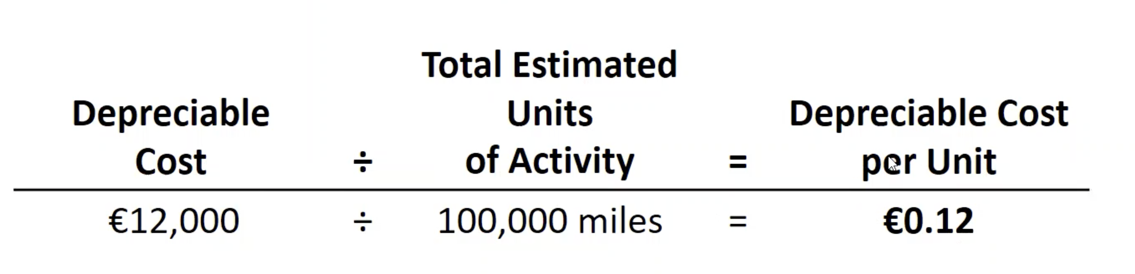
Units-of-Activity Method
Companies estimate total units of activity to calculate depreciable cost per unit
Expense varies based on units of activity
Depreciable cost is cost less salvage value
Often referred to as units-of-production method
L O 2
Notes:
When we use more, depreciate more, use less, depreciate less! Can better match expenses with revenue.

Slide 35
Depreciation Methods – Example Data
Compare the three depreciation methods using the following data for a small delivery truck purchased by Barb’s Florists on January 1, 2025:
Cost | €13,000
Expected residual value | €1,000
Estimate useful life in years | 5
Estimated useful life in miles | 100,000
Illustration 9.7: Delivery truck data
Required: Compute depreciation using the following.
(a) Straight-Line (b) Units-of-Activity (c) Declining Balance
L O 2

Slide 36
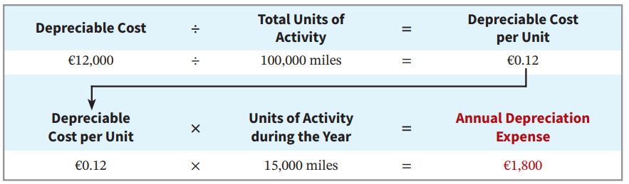
Units-of-Activity Formula
Illustration 9.10: Formula for units-of-activity method
L O 2

Slide 37
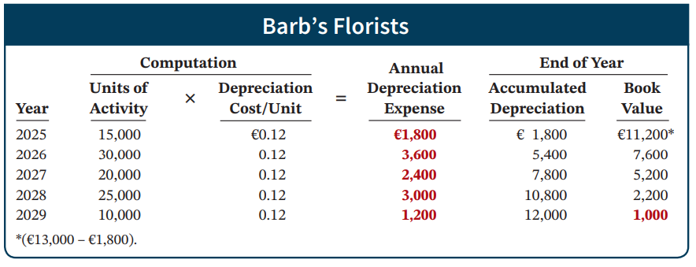
Units-of-Activity Method Schedule
Illustration 9.11: Units-of-activity depreciation schedule
Journal Entry:
Depreciation Expense 1,800
Accumulated Depreciation 1,800
L O 2
Notes:
More usage → depreciate more.
Less usage → depreciate less.
What if end of 3rd year, we reach the estimated life? What do we do? Or if we didn’t depreciate fully, what do we do?
We are allocating total cost into different periods … if we have reached, shall we further depreciate? We stop.

Slide 38
Declining-Balance Method
Accelerated method
Decreasing annual depreciation expense over asset’s useful life
There will be higher depreciation expenses in the first few years and lower expenses as the asset ages
Double declining-balance rate is double the straight-line rate (suppose straight-line method depreciate 20%, double method use 40%)
Rate applied to book value
L O 2

Slide 39
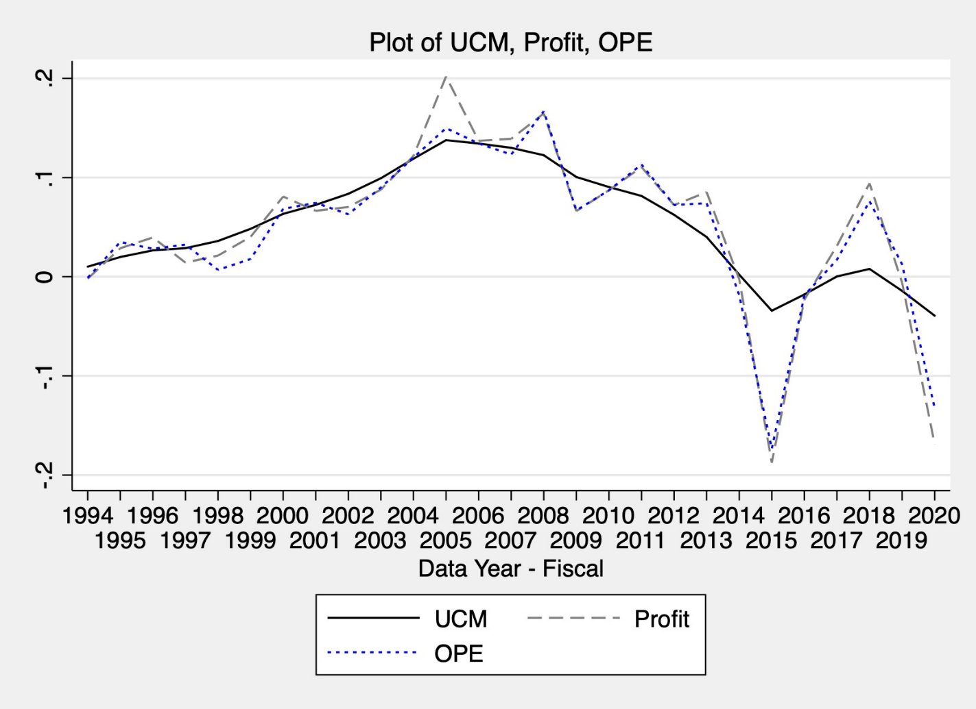
Recurring and Non-Recurring
Notes:
PROFIT & OPE → two measures of recurring earnings that are widely used in the literature.
Notice that there are peaks and valleys (extreme fluctuations)
2015 → Oil and gas impairments (they did a fair value test and had big write down)
2005 → one time gain.
We apply a statistical algorithm to the earnings time-series to back out these extreme fluctuations.

Slide 40
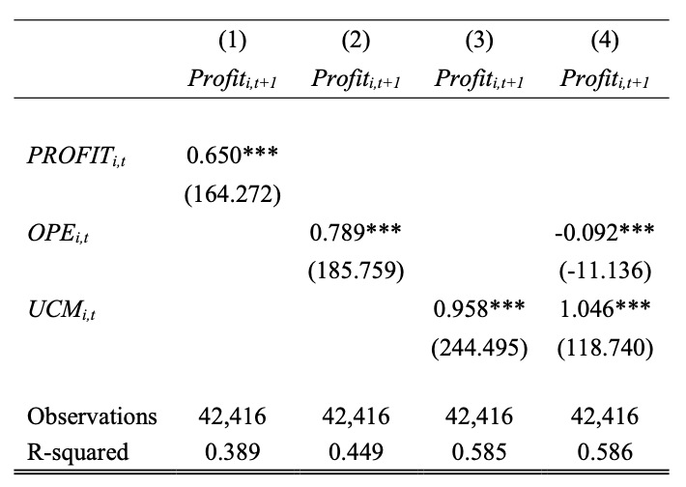
Predicting Next Period’s Earnings
Notes:
Predicts next period earnings the best.

